Slide 1


Project Hack - Python Masterclass
Dr James Smith
Chief Technology Officer
www.projectingsuccess.co.uk
Page 1 | 23/02/2019 | | www.projectingsuccess.co.uk

Slide 2
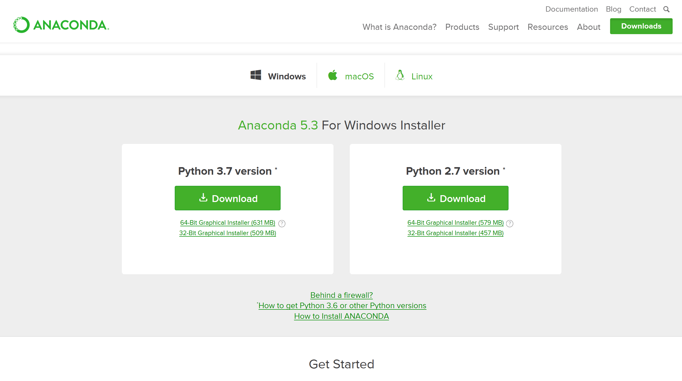
Let’s get setup.
If you want to code with me – downloaded and install Anaconda and then Python.
https://www.anaconda.com/download/
Python 3.7 or Python 2.7?
Personally, I would recommend Python 3 since it’s more modern and it’s a more popular option at this point.
Page 2 | 23/02/2019 | www.projectingsuccess.co.uk | Strictly Commercial in Confidence

Slide 3
Let’s get setup.
We’re also going to be using Twitter as well so if you don’t have an account it might be best to make one now!
Log in or make a Twitter account at https://apps.twitter.com/
Page 3 | 23/02/2019 | www.projectingsuccess.co.uk | Strictly Commercial in Confidence

Slide 4
Overview
Let’s get setup
Who am I?
The best way to learn! Maybe..
Why Python?
What can Python be use for?
Live Demonstration/workshop
Page 4 | 23/02/2019 | www.projectingsuccess.co.uk | Strictly Commercial in Confidence

Slide 5


Who am I?
Completed my PhD in applied Mathematics in 2015 – Painleve equations and Orthogonal Polynomials
Lectured mathematics at the University of Kent
Joined Projecting Success in 2017
Things I like:
Machine Learning
Python
Page 5 | 23/02/2019 | www.projectingsuccess.co.uk | Strictly Commercial in Confidence

Slide 6
Which Integrated Dev Environment (IDE)?
Save and reload code files If an IDE or editor won’t let you save your work and reopen everything later, in the same state it was in when you left, it’s not much of an IDE.
Run code from within the environment Similarly, if you have to drop out of the editor to run your Python code, then it’s not much more than a simple text editor.
Debugging support Being able to step through your code as it runs is a core feature of all IDEs and most good code editors.
Syntax highlighting Being able to quickly spot keywords, variables, and symbols in your code makes reading and understanding code much easier.
Automatic code formatting
Any editor or IDE worth it’s salt will recognize the colon at the end of a while or for statement, and know the next line should be indented.
Page 6 | 23/02/2019 | www.projectingsuccess.co.uk | Strictly Commercial in Confidence

Slide 7
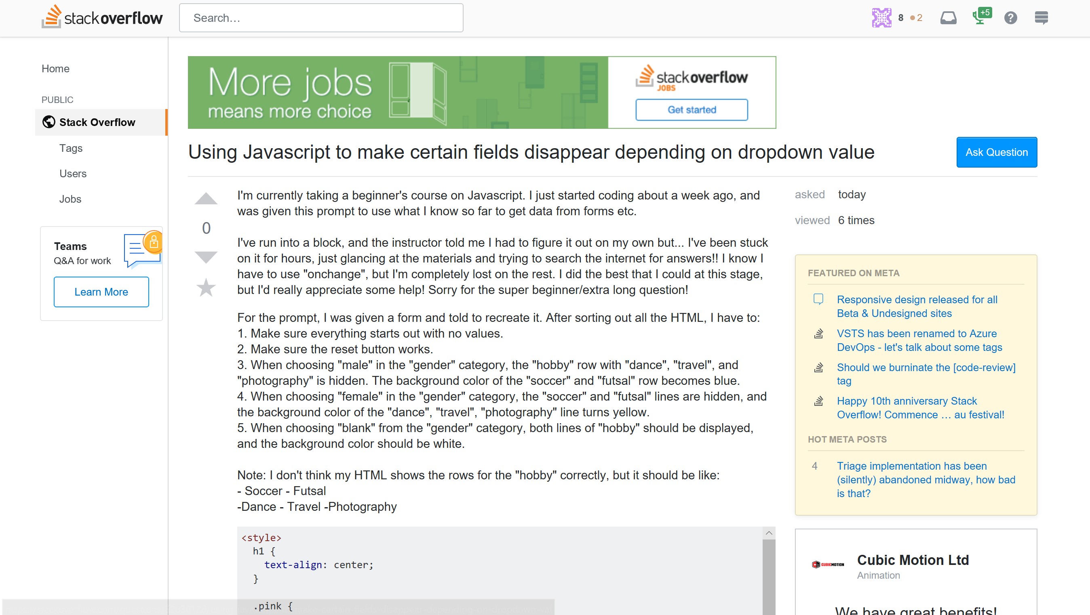
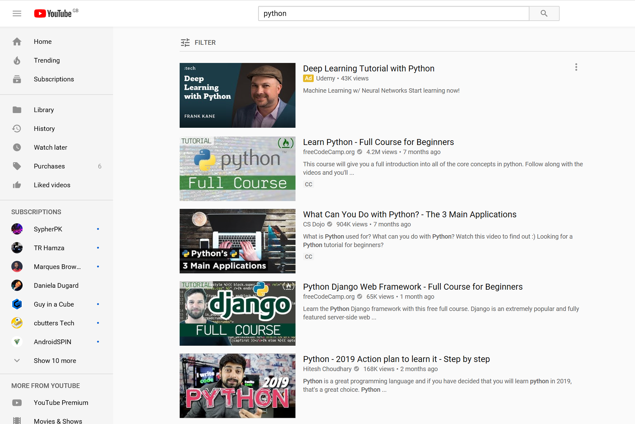
The best way to learn! Maybe…
https://stackoverflow.com/
https://www.youtube.com/
Page 7 | 23/02/2019 | www.projectingsuccess.co.uk | Strictly Commercial in Confidence

Slide 8
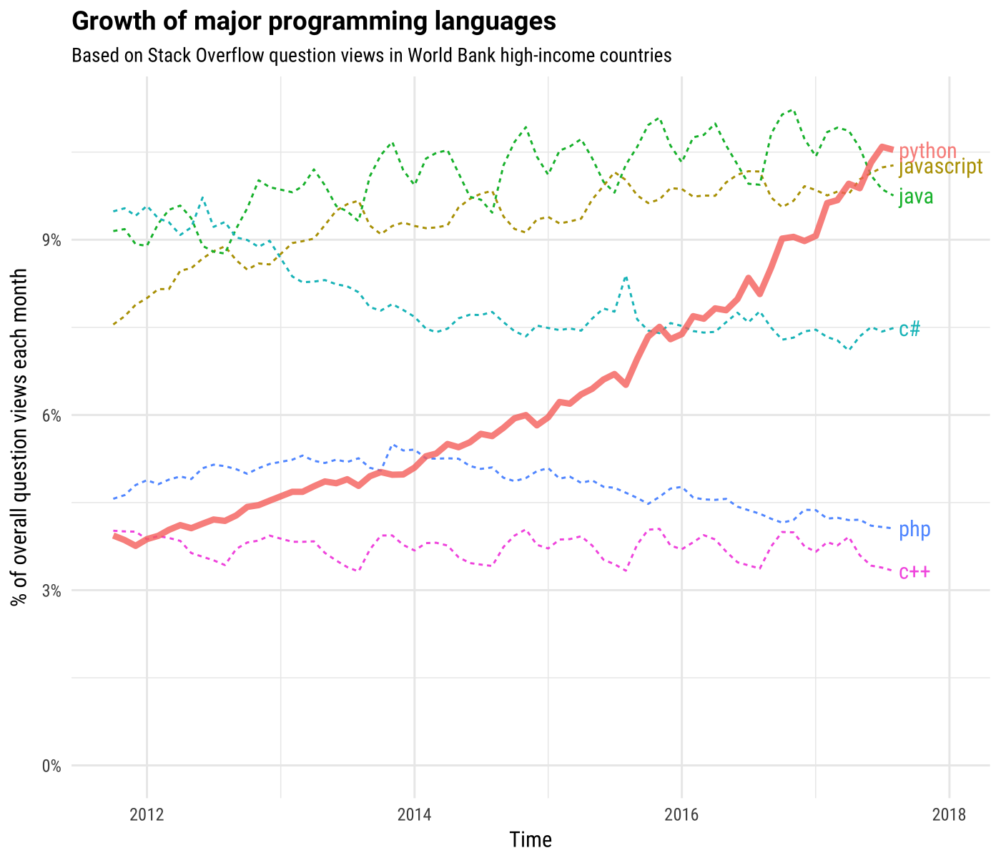
Why Python?
Page 8 | 23/02/2019 | www.projectingsuccess.co.uk | Strictly Commercial in Confidence

Slide 9
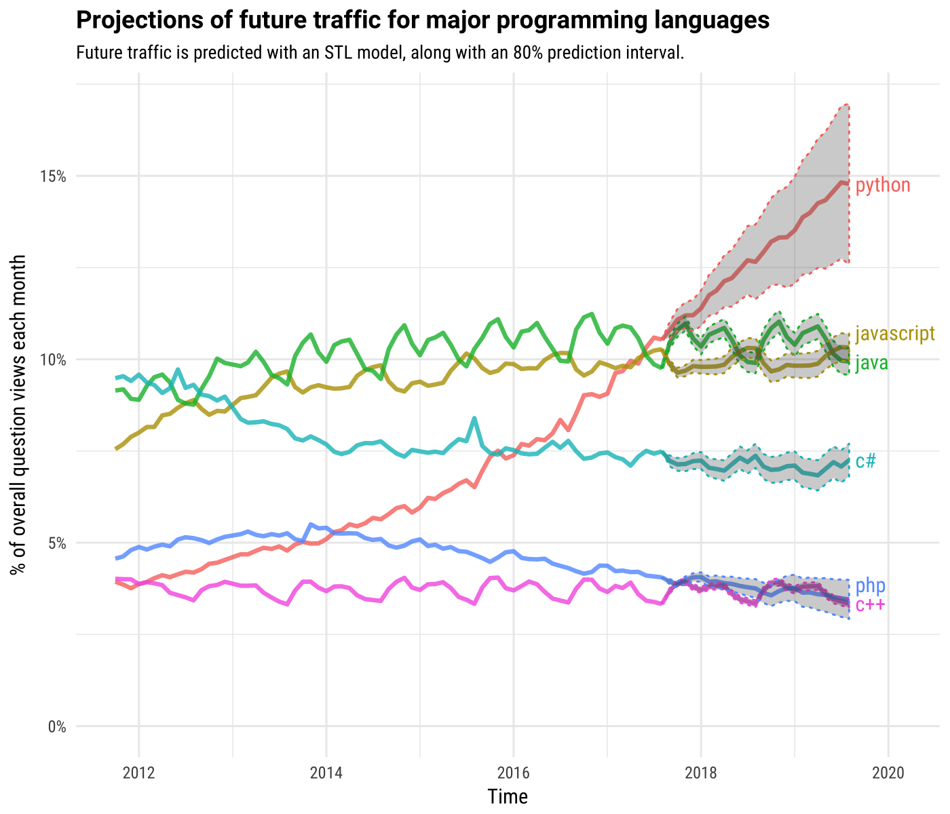
Why Python?
Page 9 | 23/02/2019 | www.projectingsuccess.co.uk | Strictly Commercial in Confidence

Slide 10
Why Python?
1. Readable and Maintainable Code
if pwd == 'apple’:
print('Logging on ...’)
else:
print('Incorrect password.’)
print('All done!')
2. Compatible with Major Platforms and Systems
3. Robust Standard Library/Many Open Source Frameworks and Tools
Page 10 | 23/02/2019 | www.projectingsuccess.co.uk | Strictly Commercial in Confidence

Slide 11
What can we use Python for?
Anything
Page 11 | 23/02/2019 | www.projectingsuccess.co.uk | Strictly Commercial in Confidence

Slide 12

Live demo/workshop
At the last Hackathon we used Beautiful Soup to web scrape some construction data but we didn’t really do much with it. Or even say what we were doing it!
This time let’s tackle a proper problem, well, kinda..
Problem statement:
Who is following Donald Trump (DT)? I want to know what percentage of Donald Trump’s Tweets are from his fans/supporters.
Okay - To do this why don’t we look at the sentiment of Tweets mentioning DT and classify them either “positive” or “negative”?
Page 12 | 23/02/2019 | www.projectingsuccess.co.uk | Strictly Commercial in Confidence

Slide 13

Live demo/workshop – Step1
To start we must all get our own Twitter keys.
consumer_key = (‘XXXXXXXXXXXXXXXXXXX')
consumer_secret = (‘XXXXXXXXXXXXXXXXXXXXX')
access_token = (‘XXXXXXXXXXXXXXXXXXXX')
access_secret = (‘XXXXXXXXXXXXXXXXX’)
To be able to download tweets using Python, we have to set up a twitter API
using the following steps:
1. Log in or make a Twitter account at https://apps.twitter.com/
2. Create a new app (top right button)
3. Fill in application creation page
4. Once project has been created, click on 'Keys and Access Tokens'. You
should see your consumer secret and consumer key. Copy these.
5. Request the access tokens. You should now have an access
token and access token secret. Copy these.
https://kaijento.github.io/2017/03/13/tweeting-with-tweepy/#creating-your-application
Page 13 | 23/02/2019 | www.projectingsuccess.co.uk | Strictly Commercial in Confidence

Slide 14
Live demo/workshop – Step 2
Navigate to my Github page to access the repo.
https://github.com/James-G-Smith/Python-projects.git
You can either clone the repo using GIT
Git clone https://...
Or if that’s too complicated (if your using a WINDOWS PC you’ll need GIT BASH or an alternative) you can simply click “Clone or download ” the repo as a zip file and unpack it on your computer.
Don’t put in on your desktop though – it’s a bad habit!
Page 14 | 23/02/2019 | www.projectingsuccess.co.uk | Strictly Commercial in Confidence

Slide 15
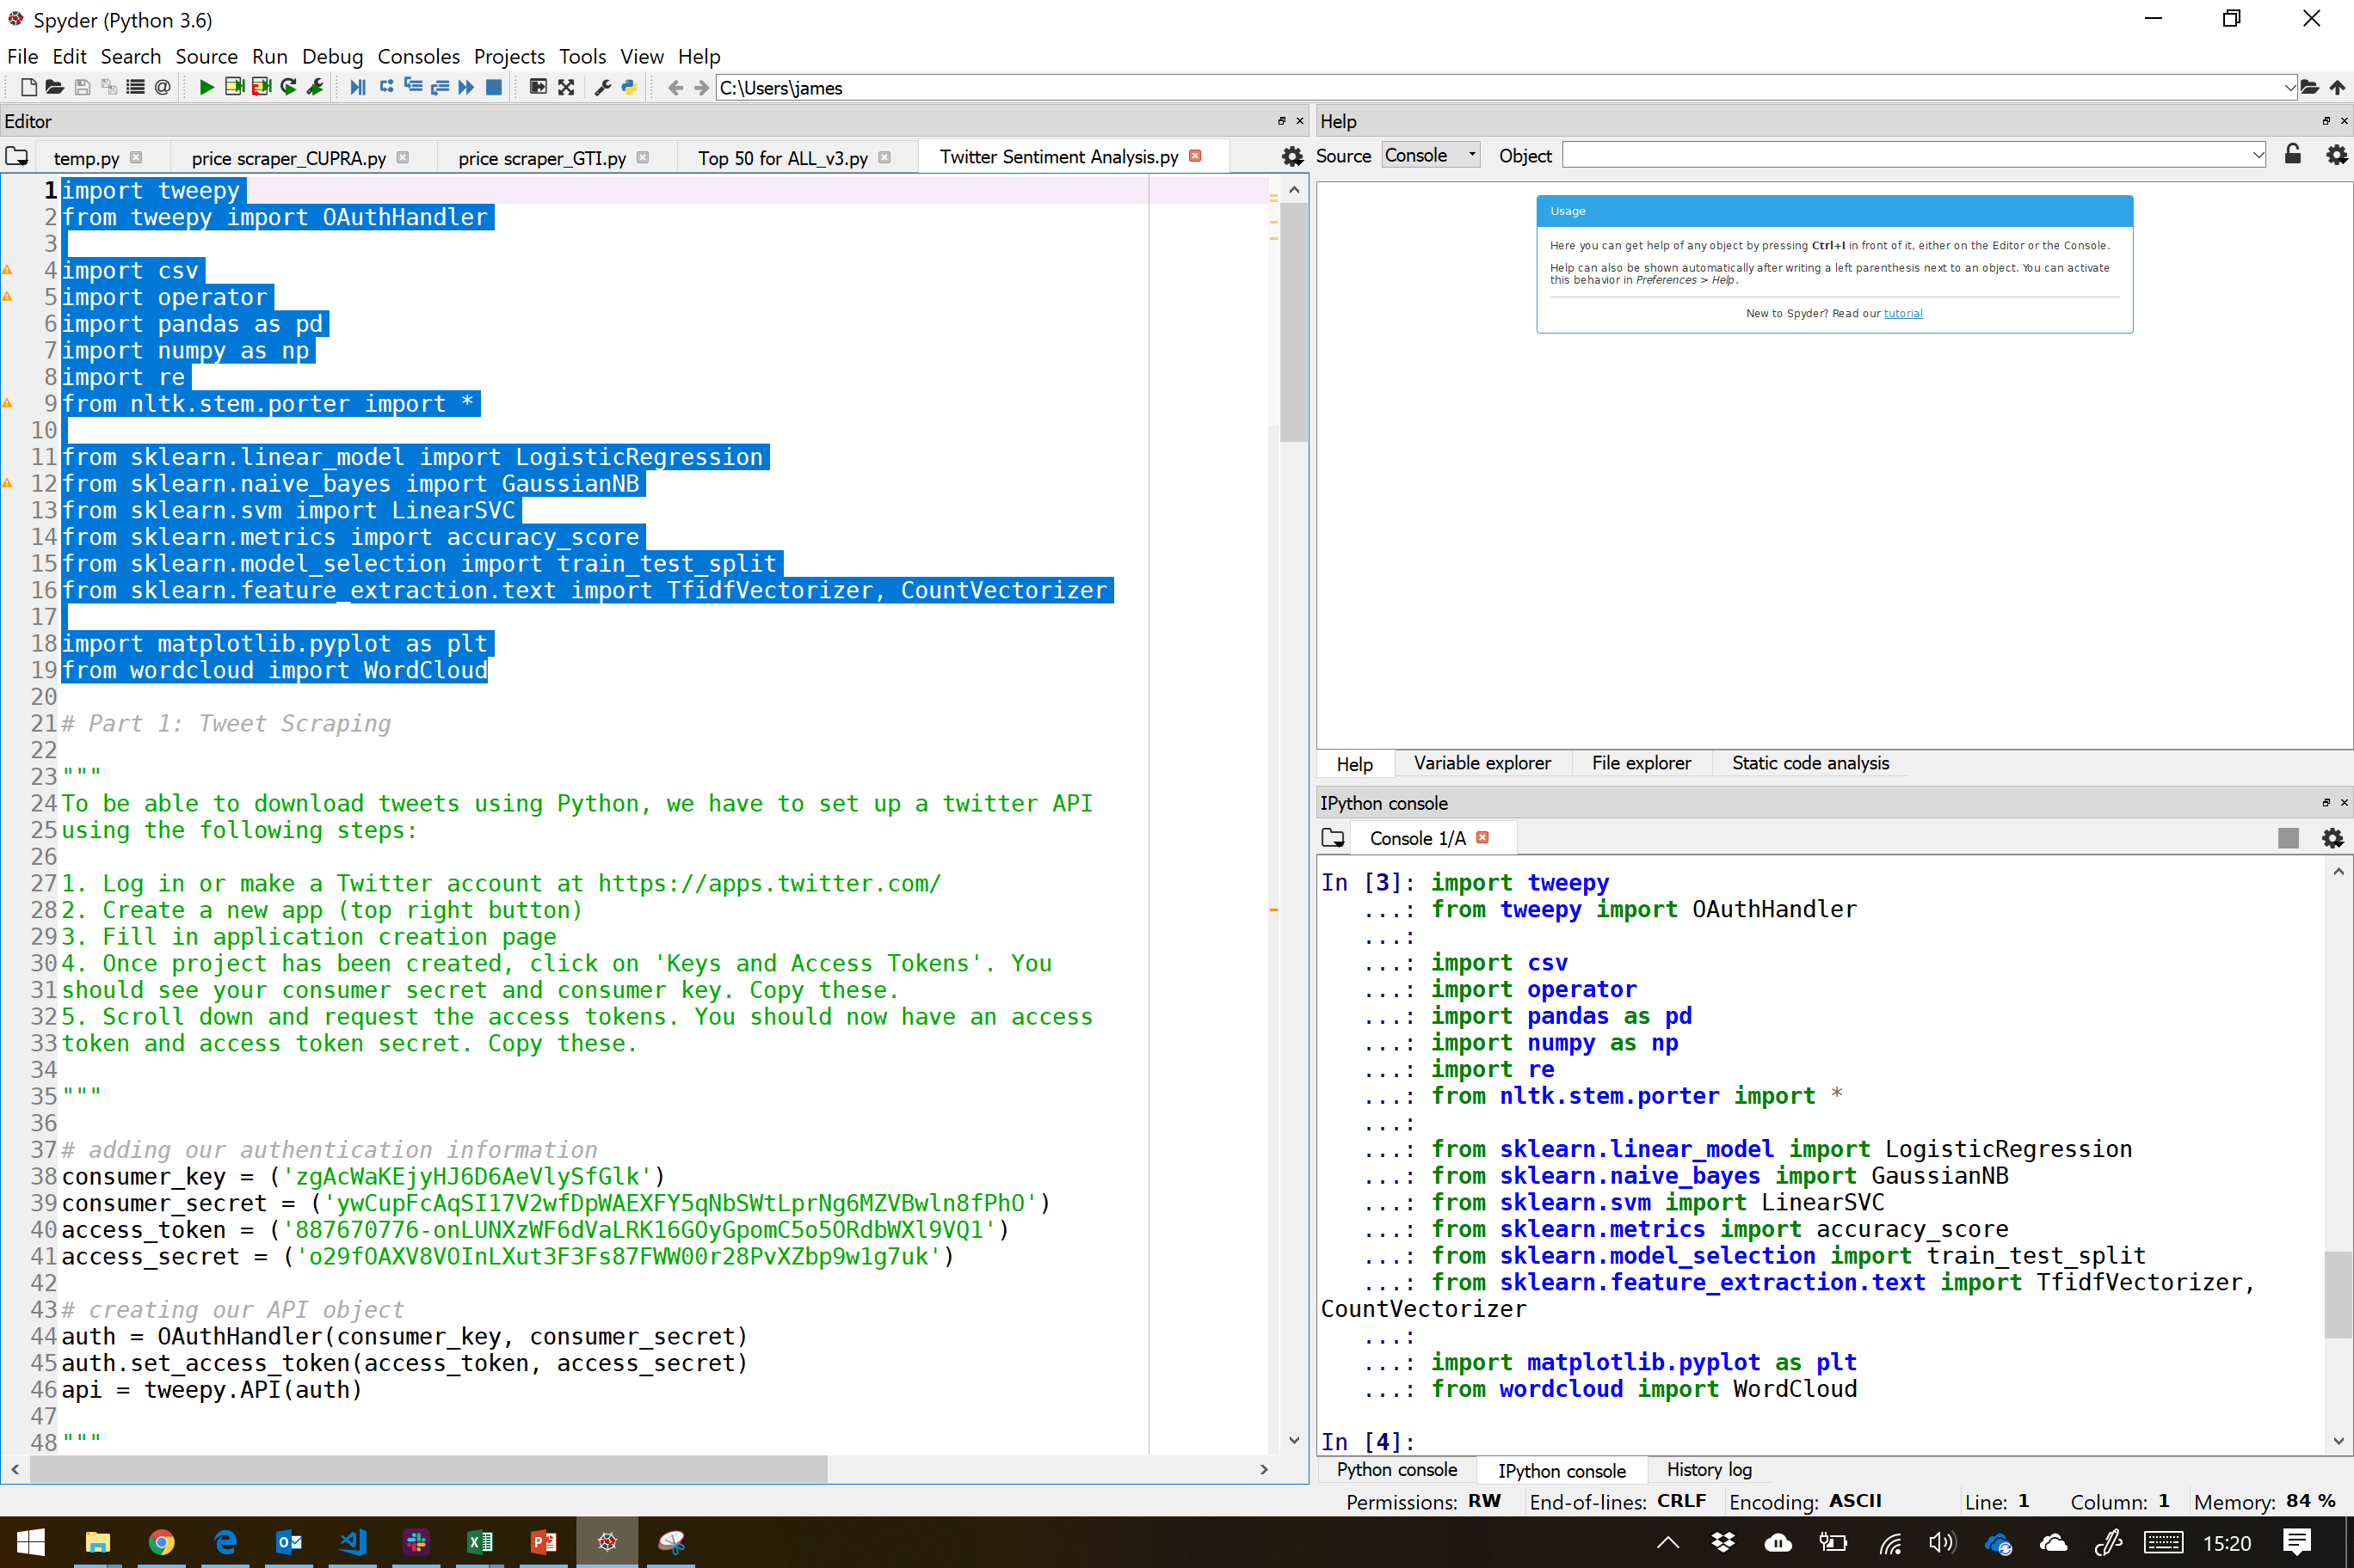
Live demo/workshop – Step 3
You will almost certainly not have ALL the packages installed and you will run in to errors…
To check what packages you need to install highlight all the packages and press “F9”.
To install these packages (globally) use the command below:
pip install PACKAGE_NAME
Page 15 | 23/02/2019 | www.projectingsuccess.co.uk | Strictly Commercial in Confidence

Slide 16
Live demo/workshop – Step 4
Open your Spyder IDE and on your own copy of the script, fill in the:
(I had hidden mine for obvious reasons)
consumer_key = (‘XXXXXXXXXXXXXXXXXXX')
consumer_secret = (‘XXXXXXXXXXXXXXXXXXXXX')
access_token = (‘XXXXXXXXXXXXXXXXX')
access_secret = (‘XXXXXXXXXXXXXXXXX’)
name = 'realDonaldTrump'
tweet_count = 1000
language = 'english'
Page 16 | 23/02/2019 | www.projectingsuccess.co.uk | Strictly Commercial in Confidence

Slide 17

Live demo/workshop
I have places breaks in the code so that we can discuss each section. Pressing
Will continue.
Page 17 | 23/02/2019 | www.projectingsuccess.co.uk | Strictly Commercial in Confidence

Slide 18

Live demo/workshop – Step 5
Firstly lets look at some Tweets from Donald Trump and see if it’s working correctly.
Run the code!
Only the first Tweet is displayed!
When you’ve done that press ENTER
Page 18 | 23/02/2019 | www.projectingsuccess.co.uk | Strictly Commercial in Confidence

Slide 19
Live demo/workshop – Step 6
Let’s retrieve our new (specific keyword, 'Trump’) Tweets and write them to disk.
Only the first Tweet is displayed!
Let’s check the CSV file
When you’ve done that press ENTER
Page 19 | 23/02/2019 | www.projectingsuccess.co.uk | Strictly Commercial in Confidence

Slide 20
Live demo/workshop – Step 7
Let’s train and test a sentiment analysis machine learning model
Firstly though we have to clean the data. I have provided some labelled data for you!
First we must:
clean
removing short words (length less than 3 characters)
Tokenize (splitting words in to meaningful tokens)
Stemming (ed, ing, etc..)
When you’ve done that press ENTER
Page 20 | 23/02/2019 | www.projectingsuccess.co.uk | Strictly Commercial in Confidence

Slide 21
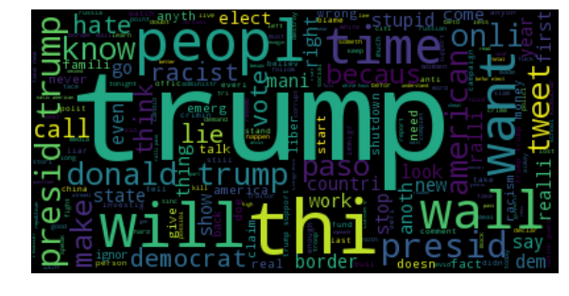
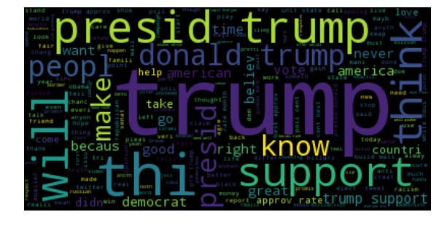
Live demo/workshop – Step 8
Using word clouds to visualize the most common words used in tweets of each
sentiment
When you’ve done that press ENTER
Page 21 | 23/02/2019 | www.projectingsuccess.co.uk | Strictly Commercial in Confidence

Slide 22
Live demo/workshop – Step 9
Let’s train and test 4 different machine models
We have split the data 60/40. 60% test and 40% train.
LogisticRegression
LogisticRegression_tfidf
LinearSVC
LinearSVC_tfidf
When you’ve done that press ENTER
Page 22 | 23/02/2019 | www.projectingsuccess.co.uk | Strictly Commercial in Confidence

Slide 23
Live demo/workshop – Step 10
Let’s read in our new Tweets and apply our trained sentiment analysis machine learning model
Sadly we have to do some ELT first!
clean
removing short words
tokenize
stemming
We can create a pie chart to show the distribution of the classifications
Page 23 | 23/02/2019 | www.projectingsuccess.co.uk | Strictly Commercial in Confidence

